Slide 1
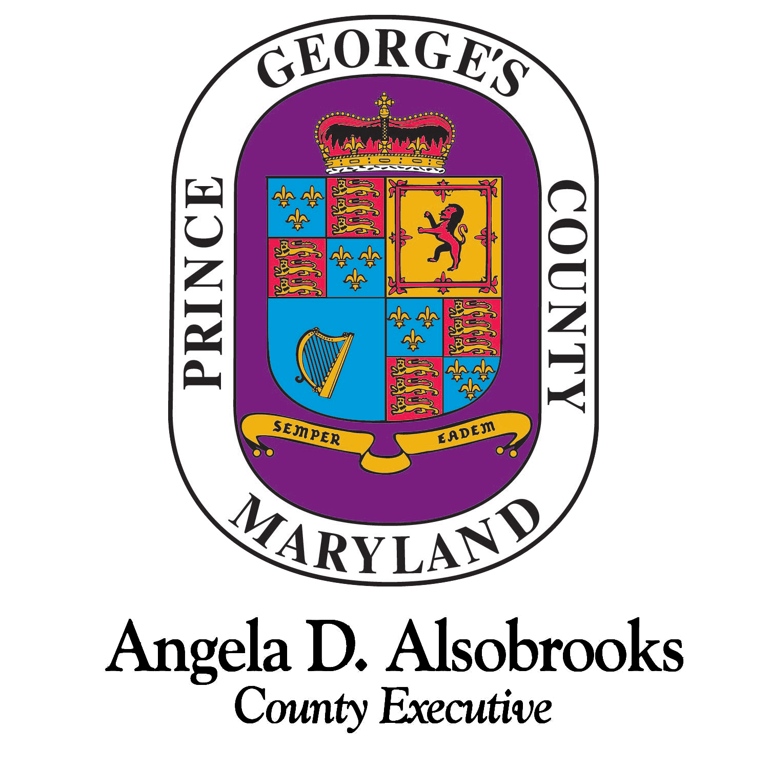
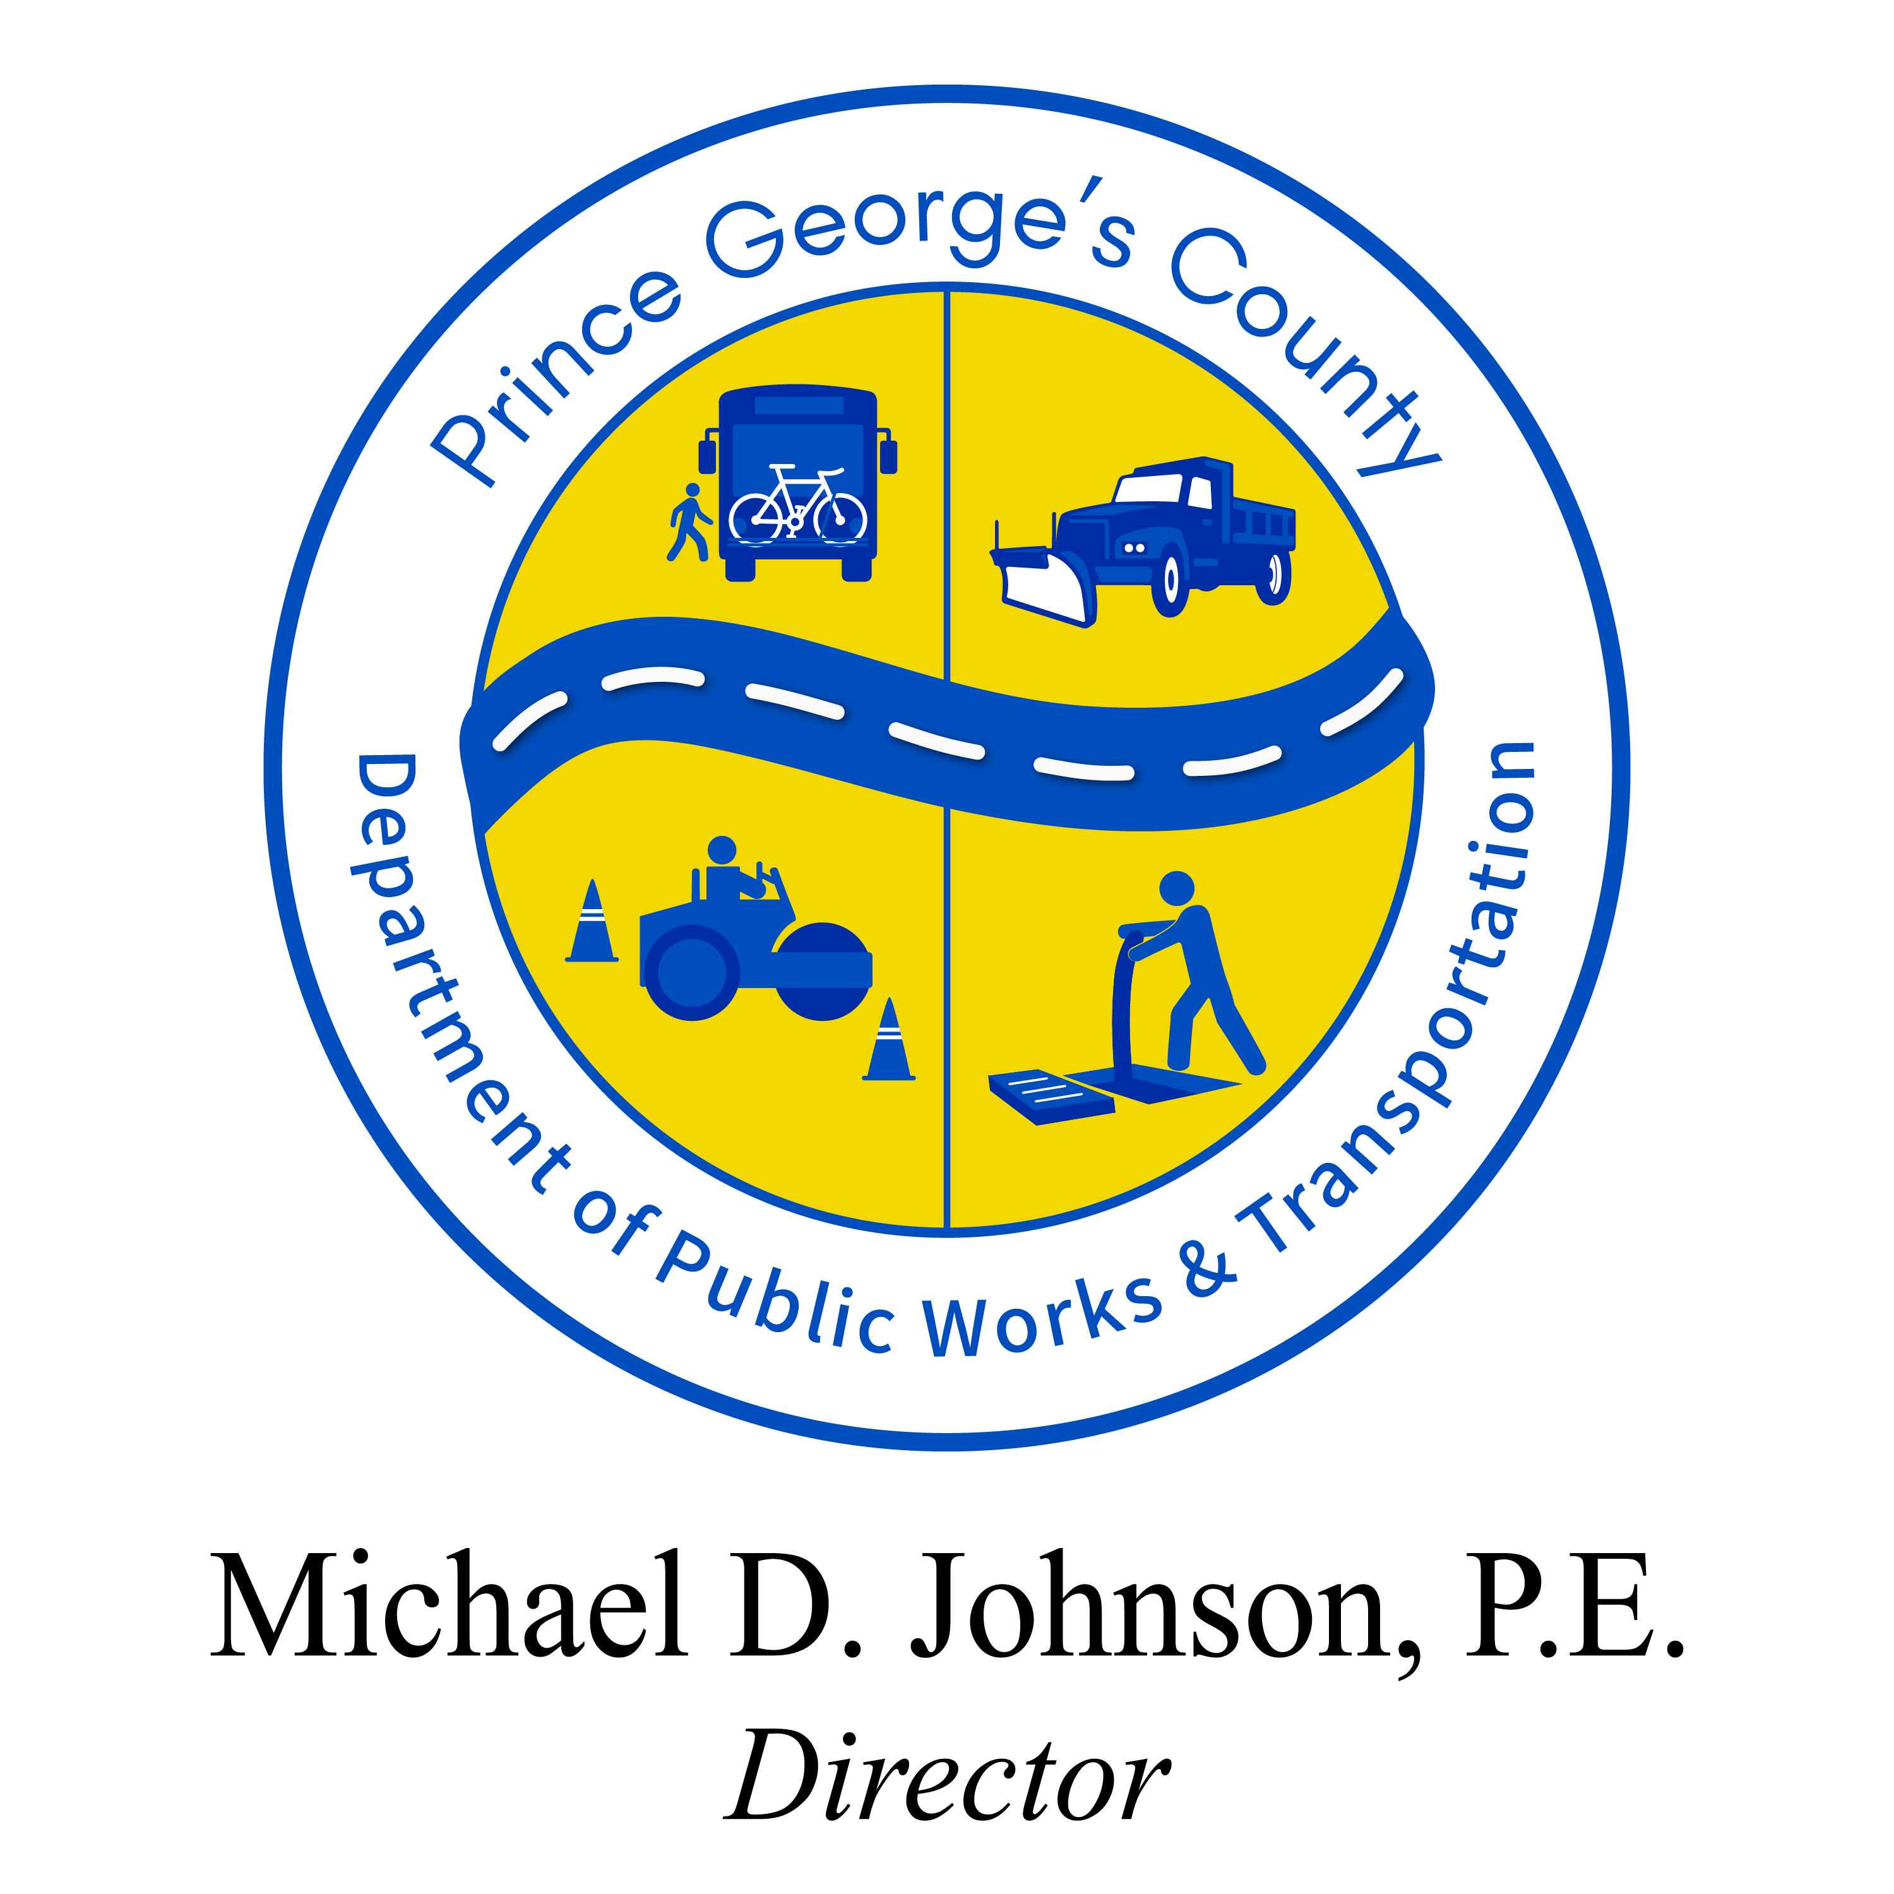
PGC Transit Transformation
Washington Suburban Transit Commission
September 2024
Department of Public Works and Transportation

Slide 2
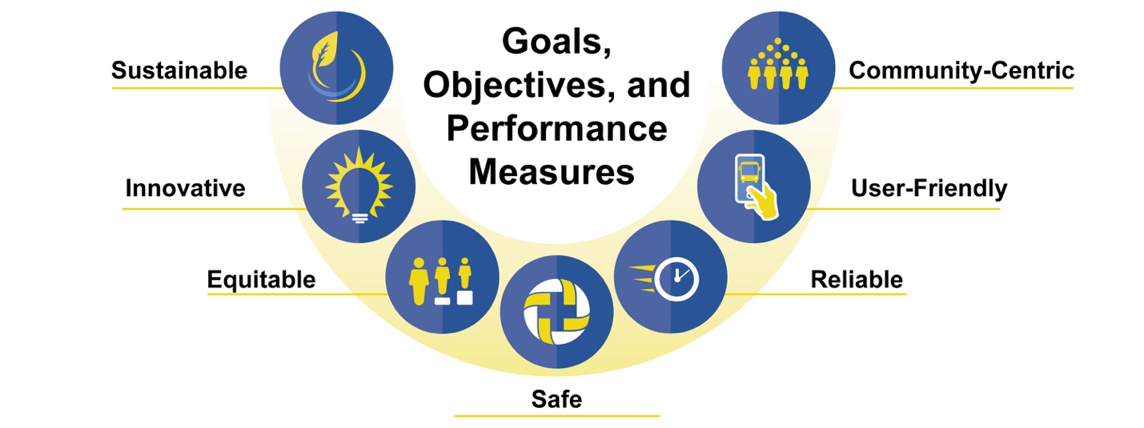
TVP Goals & Objectives
Vision: “Public transit services in Prince George’s County will be safe, reliable, user-friendly, sustainable, innovative, community-centric, and—above all—equitable, as they grow and adapt to meet the community’s evolving transportation, development and environmental needs.”

Slide 3
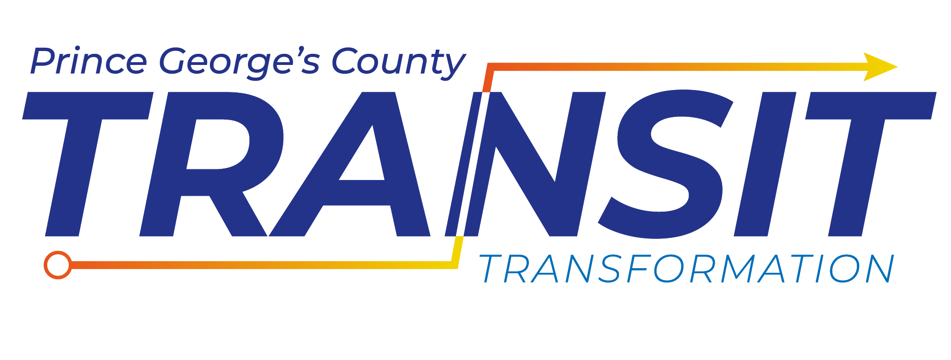
Transit Transformation
In alignment with the foundational pillars and values of PGC Transit Transformation (PGC TT), we launched the four initiatives:
Transit Vision Plan
Transit Forward
Zero – Emission Bus (ZEB) Transition
Service Changes

Slide 4
Transit Vision Plan
Assess what transit means to those who live, work, play, and travel in the County.
Understand how the system could work for current and future travelers.
Attract more users to the system, especially those who are most in need.
Meet the transit needs of users and advancing the County's goals and priorities.
Enhance the regional network and neighboring jurisdictions.
Leverage other transit investments such as the Purple Line to catalyze capital investments for regional impacts.

Slide 5
Public Input on Transit (Transportation Survey October – December 2022)
Respondents prioritized reliability, convenience, and safety
Transit service reliability is key
Buses and trains need to run on time
Service must be convenient
Buses and trains need to run frequently, stops and stations need to be close to people’s homes and destinations
Getting to transit must be safe
Sidewalks, crosswalks, walking and bike paths need to connect people to their nearest transit services
Notes:
Infrastructure needs such as maintenance facility and charging infrastructure
Fleet – how many vehicles will we need to complete service, what types of vehicles we will purchase, when we will be replacing
Training – training for drivers, mechanics, etc. Also need to understand if we need to hire more people
Phasing – this is how we will phase any construction but also how we plan to transition routes into BEB operations. This is where we will be asking you for feedback today!
Finally, the plan will include strategies and opportunities to fund the transition.

Slide 6
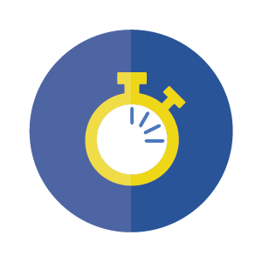
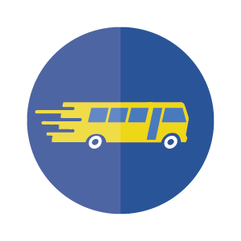
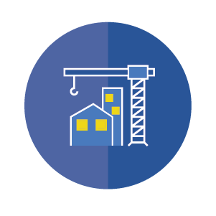
Guiding Concepts for the TVP
Expand service hours and improve frequencies
Operate more routes and more transit services
Improve service reliability and customer experience
Address land use challenges to transit success
Notes:
Battery Electric Buses
6 buses (2021 LoNo)
20 buses over 3 years (2022 BBF)
On-Route Charging Infrastructure
2 units (2021 LoNo)
3 units (2022 BBF)
Microgrid Design/Build
Supports charging XX vehicles
Begins off the grid sustainability
3-year implementation
Garage retrofits
Workforce Development

Slide 7
What is the Aspirational Network?
The Aspiration Network is a bus network created to address the identified transit needs and gaps
The Aspirational Network was created in collaboration with Prince George’s County and WMATA
It includes both TheBus and Metrobus routes
Builds on WMATA’s Better Bus Network Redesign (BBNR) 2025 Network
Notes:
We are here to build long-lasting relationships with the public, passengers, and stakeholders in building stronger ties with communities and those that we serve. As one of the biggest economies in the State of Maryland, Prince George’s County is the GREAT CONNECTOR not only to opportunities in the region but also across the East Coast.
As a lifelong Prince Georgian, I am Prince George’s Proud of our goal to achieve a world-class, integrated, EQUITABLE, public transit network that EXPANDS people’s access to opportunity, RECONNECTS communities, and makes transit the most convenient and competitive way of getting around in the County.
I’m excited for this new season in transit and want to thank each of you for being here today and working in partnership with the County to advance these critical initiatives in Prince George’s County.

Slide 8
More Routes Going More Places
Increases service, while making service more frequent and direct
More direct connections between more places
Together, TheBus and Metrobus would operate nearly twice the service* they do today
Additional 27 sq. mi. would be within walking distance of bus service – an 11% increase in bus coverage
*Measured in Service Hours
Notes:
The Transit Vision Plan aims to comprehensively review the current transit system (paratransit, micro-transit, and bus network) and provide recommendations to improve transit service throughout Prince George's County over the next five years. This study allows for a fresh look at the county-wide transit network applying our five foundational pillars. The Transit Vision Plan allows us to meet your priorities: reliable service, accessibility, faster travel, better connections, and ease of use.
Summer & Fall 2023
TVP stakeholders outreach with municipalities
Coordinated meetings with WMATA and stakeholders
Draft Existing Conditions, Service Profiles and Financial Assessment Reports
The county conducted a survey on transportation from October to December 2022. The results tell us:
Transit service reliability is key: Buses and trains need to run on time
Service must be convenient: buses and trains need to run frequently, stops and stations need to be close to people’s homes and destinations
Getting to transit must be safe: sidewalks, crosswalks, walking and bike paths need to connect people to their nearest transit services

Slide 9
Focus Area
The Aspirational Network provides more – and more frequent – connections to Focus Areas
Bowie Town Center
Greenbelt
Hyattsville Crossing/W. Hyattsville
Landover
Largo Town Center
Laurel Town Center
National Harbor
New Carrollton
Suitland
Focus Areas are key locations for transit investment:
Population & employment growth
New development
TOD & equity focus areas
Major transit investments

Slide 10
Transit Forward
Transit Forward continues to analyze the quality, effectiveness, and delivery of services:
We are implementing updated operational procedures – new handbooks, enhances safety measures
Funding has been identified for a new transit facility feasibility study, phases one & two of the microgrid project, additional charging infrastructure
Launched the transit experience team that interacts with existing and potential riders weekly.

Slide 11
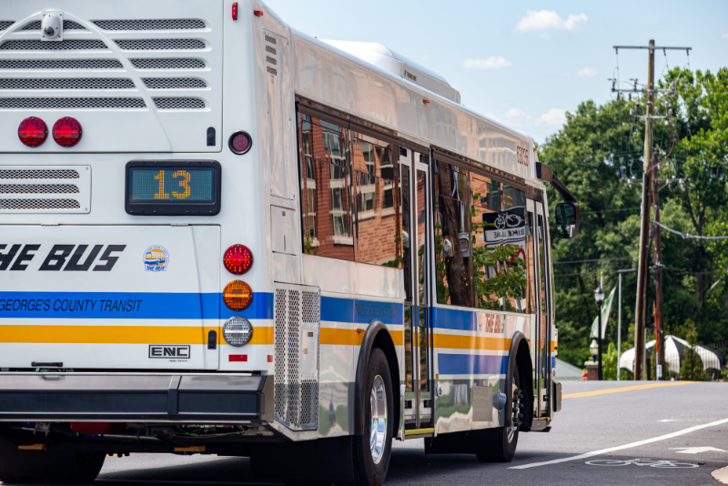
Fall 2024 Service Change
DPW&T continually evaluates the progress and performance of our multi-modal transit services
Public and transit operator Engagement
Analysis of transit data and draft recommendations
Public feedback inclusion

Slide 12
Transit Transformation - Rebranding
Rebranding Efforts to Date and Timeline
We have a clear vision and a firm plan in place for Rebranding the Agency’s Transit Program Names, Logos and Taglines!
Accomplishments to Date:
September 1, 2024, delivery of a graphic design for a Transition Advertising Bus Wrap for the 15 Bio Diesel Buses, expected to arrive in early 2025
A Focus Group – Determined two new names for “TheBus, Call-A-Bus, and PGC Link”. Further research will be conducted for additional options
Completion by Spring 2025 (End of FY24):
Bus Wrap of over 100 Buses, a uniform new design
New Names, Logos, and Taglines for the PGC Transit Programs
A 35 Year Anniversary Logo
New Uniforms
New Bus Blades (Bus Stop Signs)

Slide 13
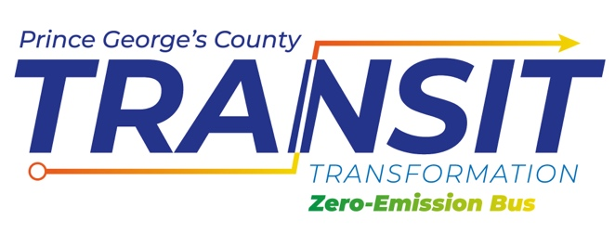
Zero Emission Bus Transition
FY24 Low or No Emissions Grant Award:
Prince George's County was awarded $25.4M funding to support a local match of $13.7M to buy battery-electric buses and fund the Phase II of their Microgrid clean energy generation project – at total cost of $39.2M - bringing the county closer to transitioning its bus fleet to fully zero-emission by 2040.

Slide 14
ZEB Transition Studies & Projects
ZEB Planning Studies
ZEB Implementation plan (2022)
PGC ZEB Transition Plan (2024)
Route and fleet models (2023)
Microgrid conceptual plan and cost est. (2023)
Fleet Management Plan/ZEB Acquisition (2025)

Slide 15
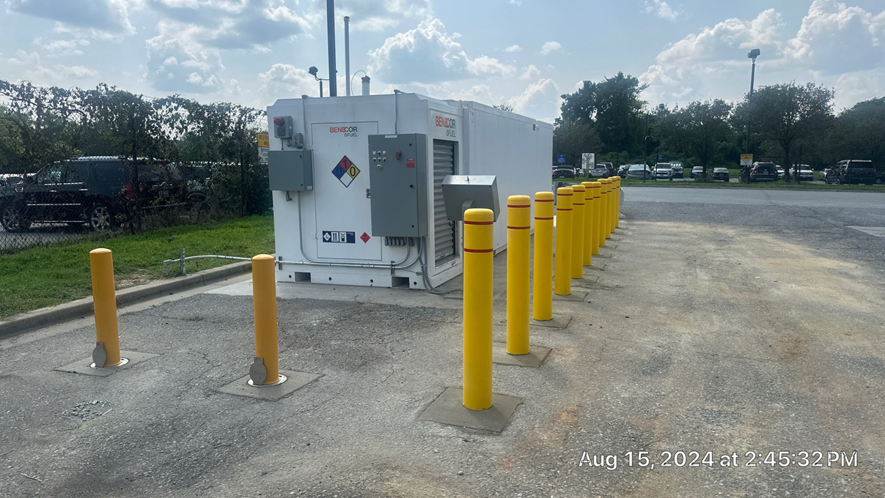
Biodiesel Pilot
The pilot aims to mitigate risk of 100% BEB fleet and provide cost effective solution to reducing carbon footprint:
Six buses and tank installation completed.
Project is expected to be completed in October 2024.

Slide 16
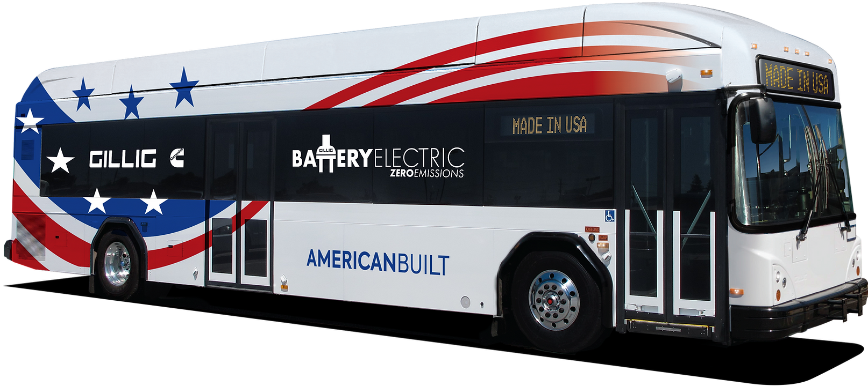
BEB Acquisitions
Short-Term Bus Orders - for Battery Electric Buses:
Five Gillig BEBs on order for delivery June 2025
Acquisition of six additional Gillig BEBs by the end of 2025

Slide 17
Charging Infrastructure
On-Route Charging
Two Level Three and Two Level Two Chargers at D’Arcy Road Facility
Two Chargers at Brandywine Facility

Slide 18
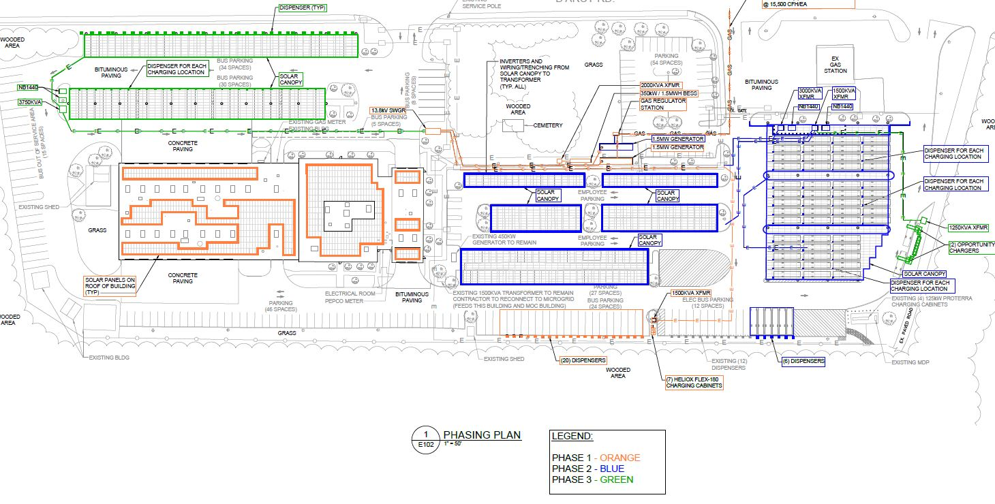
Microgrid Design & Build

Slide 19
Closing Remarks/Comments

